Slide 1
Champlain Tours
App Dev Team Lead: Matt Ellison
SEO Team Lead: Tai Martinez
Notes:
Tai
Hello and welcome everyone. My name is Tai Martinez and this is my co-lead Matt Ellison. This semester we worked with Champlain Tours...Next slide

Slide 2
Our Client
Champlain Tours
Owner and operator Keith Neil
A travel agency
Located in Burlington, Vermont
Focus on providing stress-free global travel experiences
Single day trips and multi-day vacation experiences
Trips range from exotic vacation experiences to philanthropic service trips
Notes:
Tai
Champlain Tours is a travel agency owned and operated by our client Keith Neil out of Burlington, Vermont. Champlain Tours focuses on a stress-free global travel experience with trips ranging from exotic vacation experiences to philanthropic service trips. (next slide)

Slide 3
Teams Overview
App Development Team
Quintin Barrette
Matt Ellison
E Fraire
Brendan Gingras
Justin Karpan-Lowman
SEO Team
Mauricio Aquino
Swan Garcia
Sam Layton
Tai Martinez
Gavin Urban
Notes:
Matt and Tai
Tai: This semester, two great BI teams got the opportunity working with Keith and Champlain Tours. I’ll let Matt introduce the App Team… (then I’ll introduce the SEO Team) -> Next Slide

Slide 4
Goals: SEO Team
Vision
Grow the company by increasing web presence
Optimize SEO through social media and marketing
Deliverables
Research
Facebook community pages
Slogans
Automated posting account using Buffer
Social Media: Example Posts, How-To Guides
Advertisements: Specific trips, specific customers, general advertisements
Logos: App and Company
Notes:
Tai: For the SEO team, our goal was to help grow the company by increasing web presence and help optimize SEO through social media and marketing. We accomplished these goals with several deliverables. The first being extensive research including how to optimize SEO, how social media platforms prioritize posts, and when the best time to post is just to name a few. The second deliverable is setting up Facebook community group pages. These community pages connect past customers and provide a place to share common posts about trips. The third deliverable is various slogans that can be used across all social media platforms, in advertisements, and merchandise. The fourth deliverable is a way to automatically post to social media using the Buffer.com application. (Next Slide) Keith explained how it was often difficult to alway be active on social media because he is the sole operator of Champlain Tours so we created a buffer account that can post to Facebook, Instagram, and Twitter at the same time either immediately or based on a specific schedule. I will now pass it over to Gavin who will explain our next deliverable with social media.
Gavin: Social Media and Advs
Sam: Targeted Ads and Logos

Slide 5
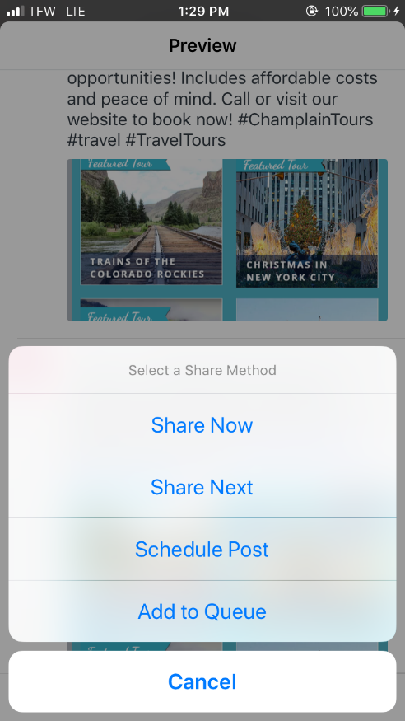
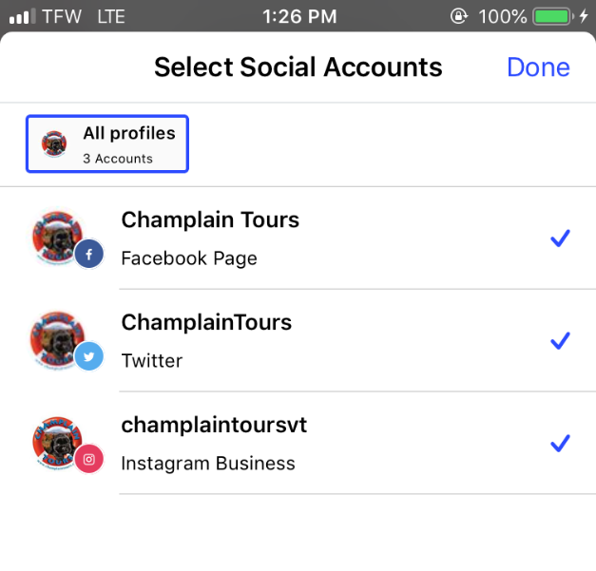
Automated Posts
Notes:
Tai: (Script on Previous slide)

Slide 6
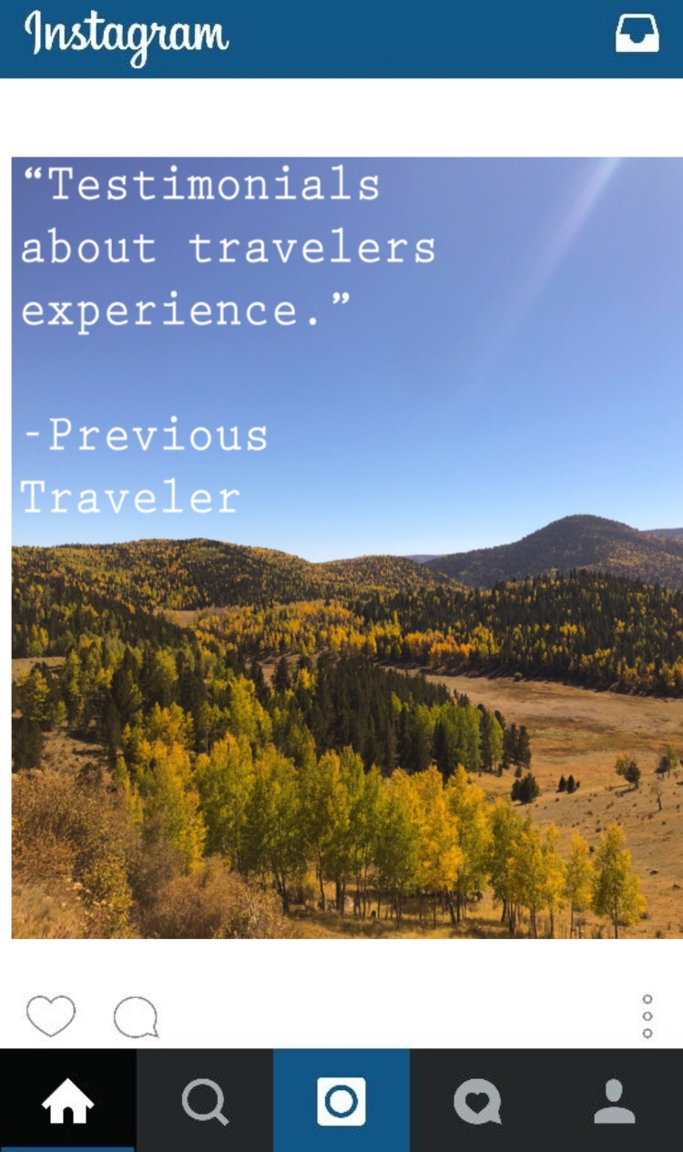
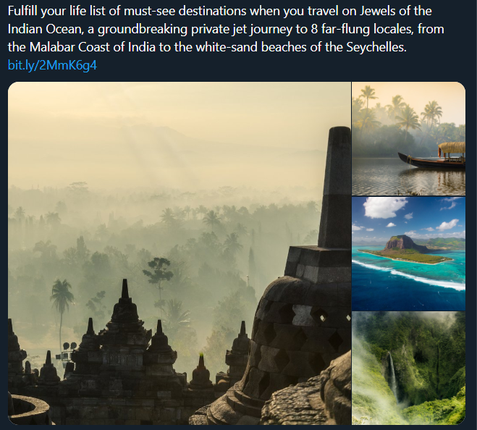
Social Media
How to Guides:
Step by step guides
Best times/days to publish posts on each account
How to receive more interactions on posts
Example Posts:
Notes:
Gavin
How to guides: In conducting research for social media, we created multiple step by step guides for Keith to use in order to improve his social media presence. These guides included the best times and best days to publish posts on each account, being twitter, facebook, and instagram. We also researched how to receive more interactions on posts, which would lead to an increase in his social media following.
Example Posts:
Along with the how to guides, we created example posts, based on the information we gathered, that Keith can use to base his future posts off of. These were created accounting for all the information we gathered based on each social media platform. A couple examples we made can be seen here on the right.

Slide 7
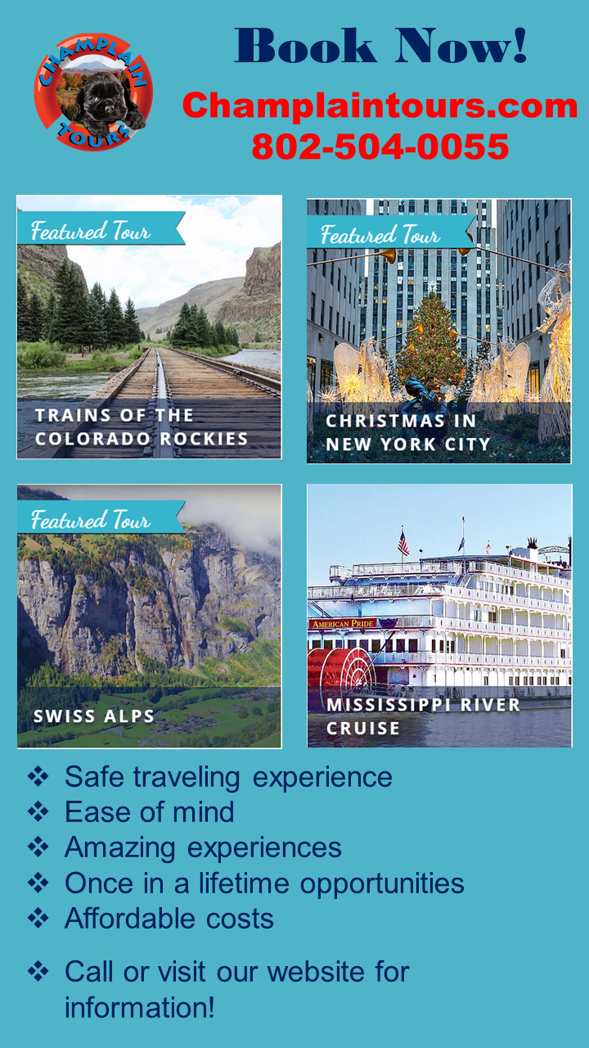
Advertisements
Notes:
Gavin
After showing Keith our how to guides and example posts, he asked if we could each create a handful of ads for some of his upcoming trips. Each of us on the SEO team created 3 ads for 3 different trips. One of those ads can be seen here on the left. We also decided to create just a general ad, which can be seen on the right, for the company to show some upcoming trips all in one, and to just draw in more volume to book trips. We also made an ad to advertise the upcoming release of the app that is being developed so Keith consumer base can be aware of that if they choose to go another trip in the future. I’m now going to pass it over to Sam to discuss some ads we created focused on targeted audiences.

Slide 8
Targeted Advertisements
Notes:
Sam
In response to research regarding the demographics of Keith’s users, as well as feedback from the professors, we adjusted our ads to target specific customers. First, we found that Keith’s user base (people ages 55 to 85) use Facebook over other social media sites. Therefore, we adjusted our ads’ text to reside within images and chose visually interesting background pictures to draw the audience’s eye.We’ve seen that these adjustments work well for ads posted on the site because images are what’s most visible. We also restricted ourselves to using a limited set of sans serif fonts. We found fonts that improved readability those visually impaired, building the visual attractiveness of our advertisements.
We created a few advertisements which supposed the children were customers and their parents were the users. For these, we altered the visual style as well as the language to appeal to giving back to one’s family.

Slide 9
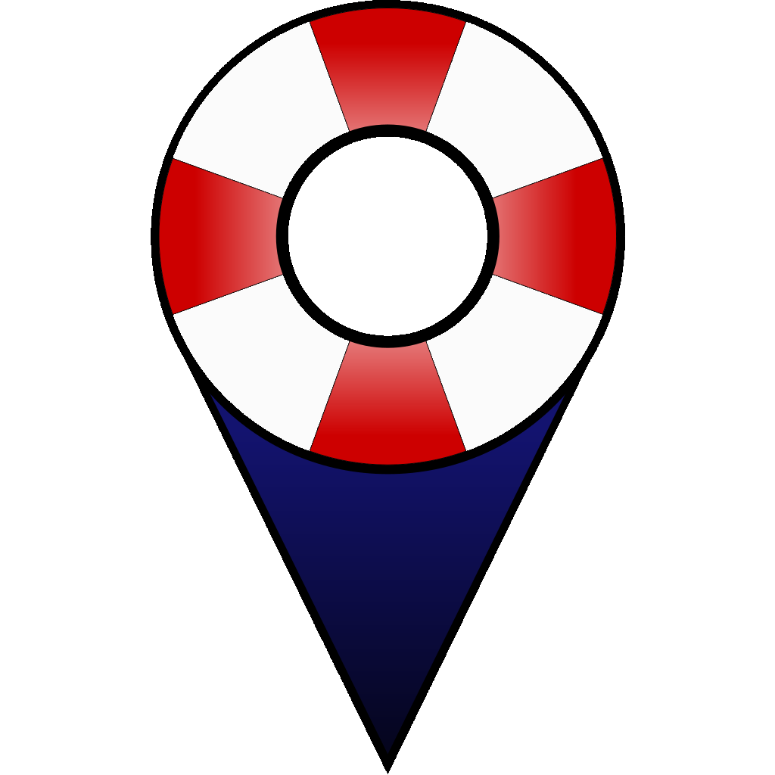
Logos
Company Logo
App Icon Logo
Notes:
Sam
And to serve as a capstone for Keith’s marketing portfolio, we designed a new company and app logo for Champlain Tours. This began with identifying the key traits of the existing logo, and finding new ways to represent them in our own designs. We wanted a logo that suggests “safety in travel”. Therefore, we integrated the life preserver into several designs. After the team made dozens of prototypes, we took them to Keith for feedback. We refined the best design into what you see on the slide.
Because Keith wants to expand his business’ identity through merchandise, we modified copies of the final logos into black-and-white variants. Keith can use these images to easily print or embroider the new logos onto shirts, hats, and other items.
On moving away from the app’s logo, Matt will talk about the app itself.

Slide 10
Goals: App Development Team
Vision
Enhance the customer experience while on tours
Provide a means for customers to locate the tour guide
Provide a means for the tour guide to locate customers
Provide access to their itinerary
Add an additional sales channel
Deliverables
Functioning cross-platform mobile application prototype
Notes:
Matt
Hand it over to justin, who will discuss the app wireframe prototype he constructed

Slide 11
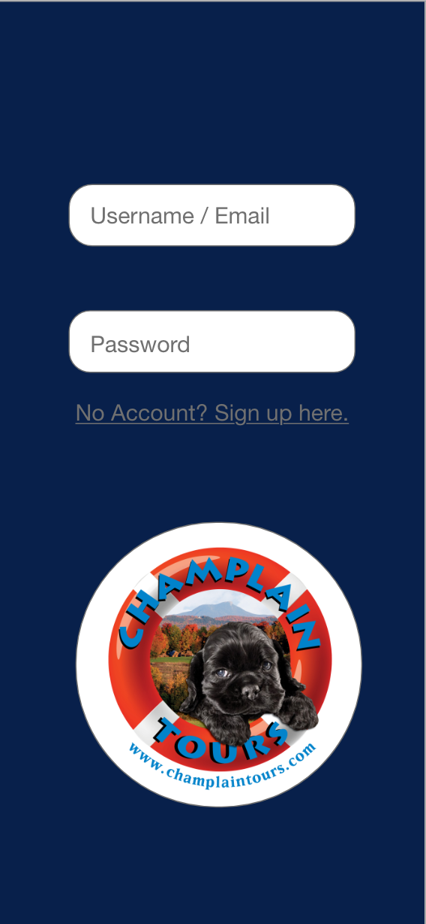
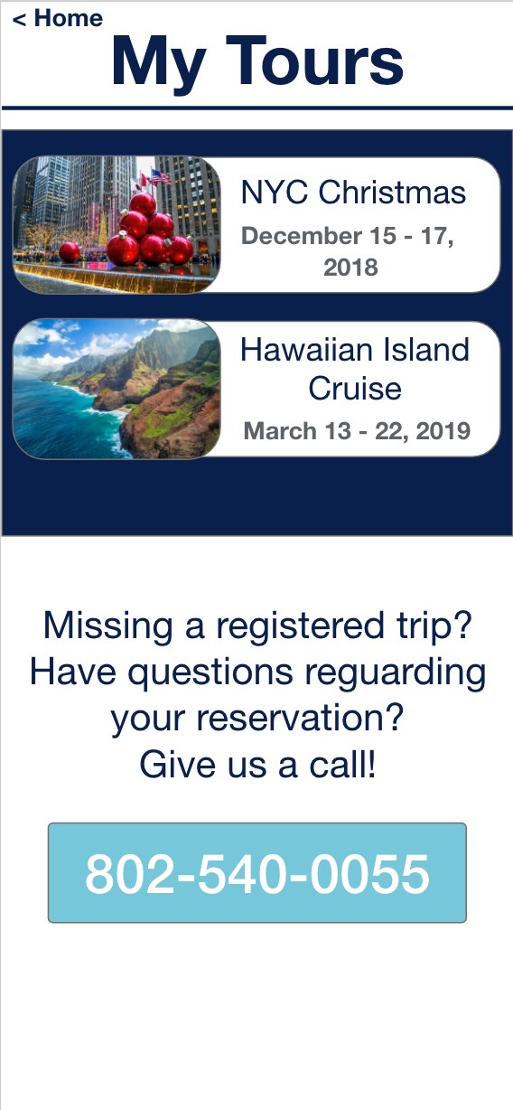
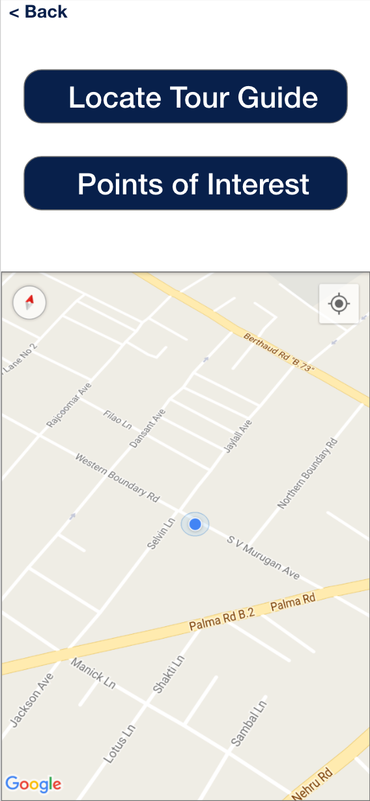
Wireframe Prototype
Notes:
Justin
Intro: The first step in the app creation process, and satisfying the minimum requirements of our charter was creating a prototype of the app, a basic wireframe of sorts of all the pages.
Middle: (explain each section)
Outro: We far exceeded the charter, as we created a fully functioning cross platform app that is more than just a few pictures as seen here.

Slide 12
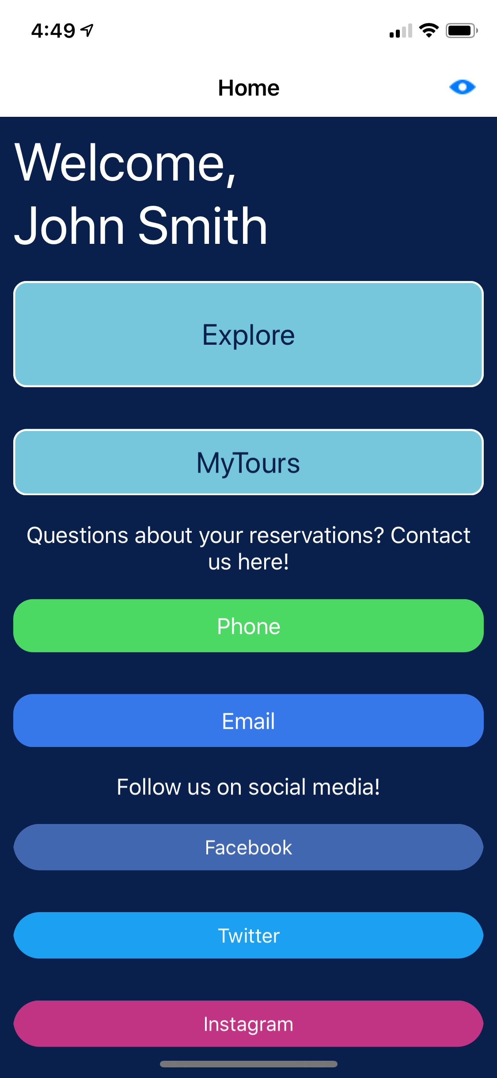
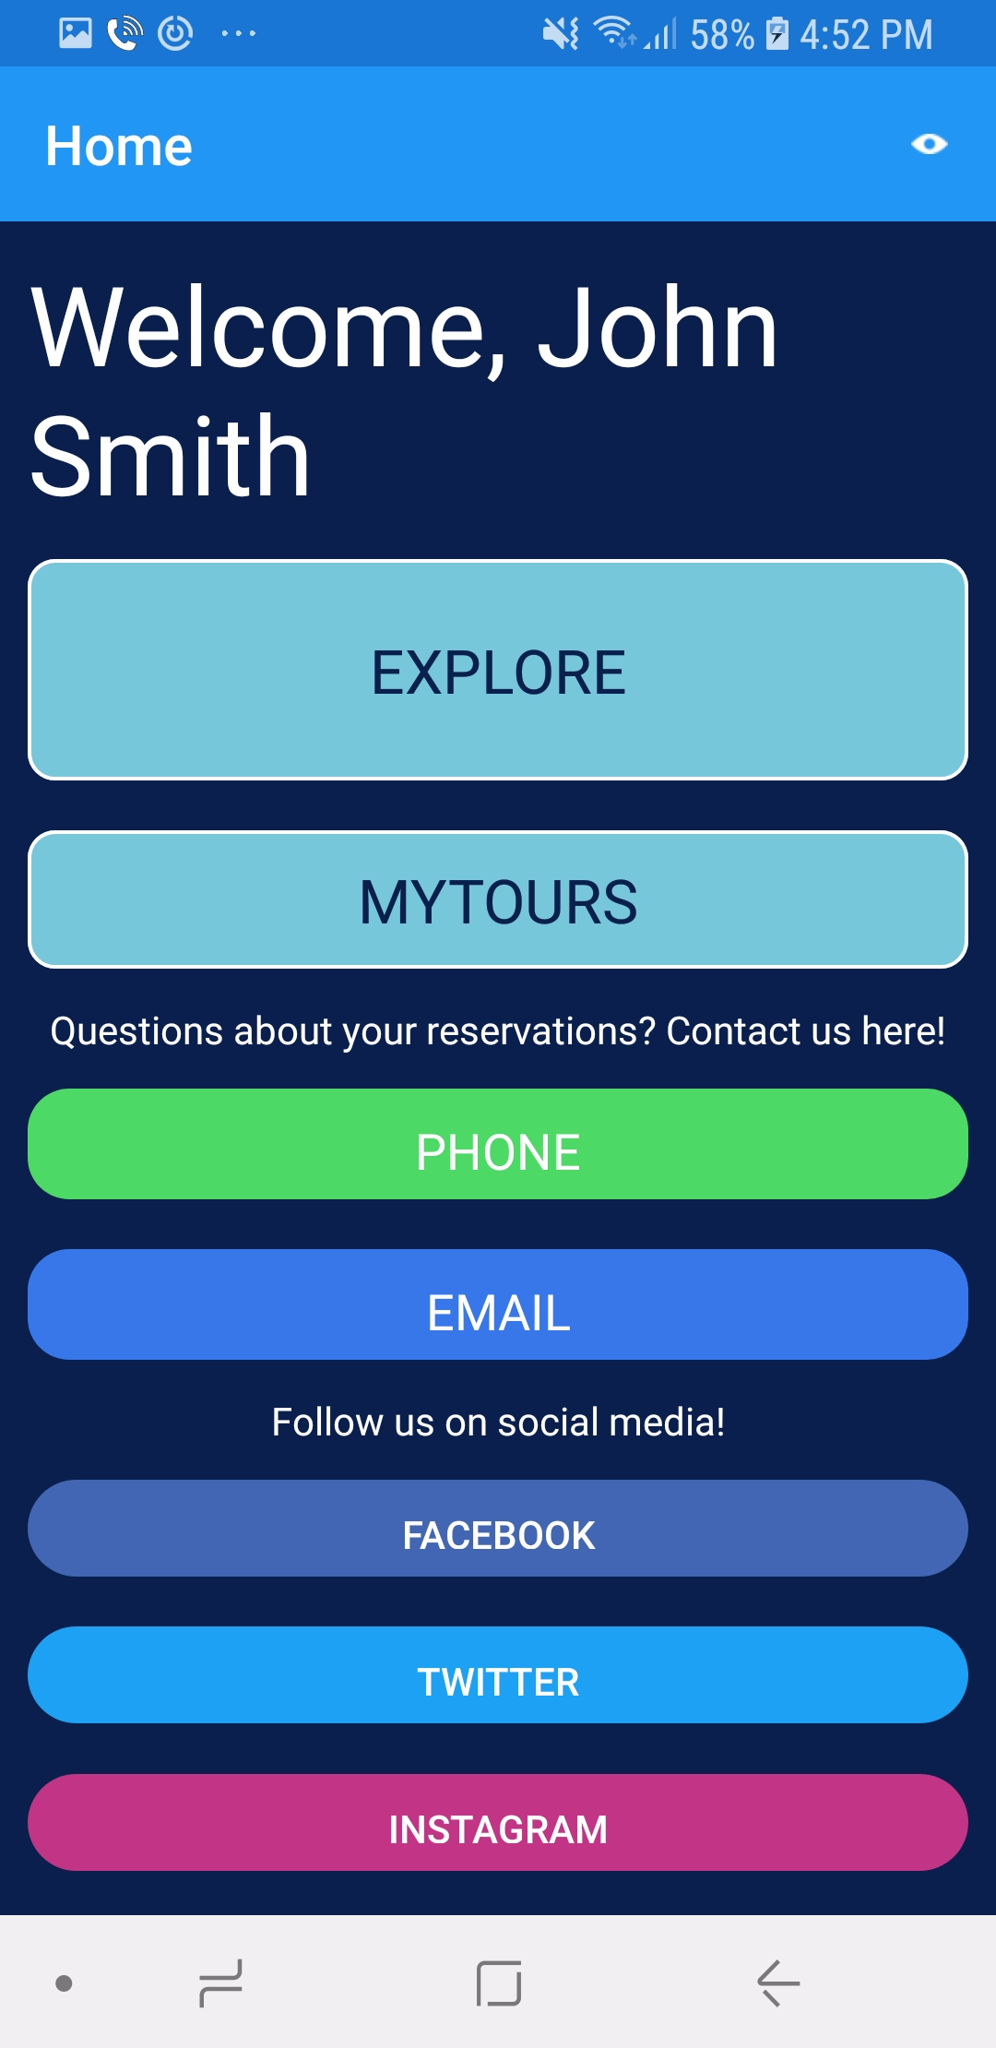
Functional Prototype: iOS and Android
Notes:
Quintin -
Intro: Our app was coded in such a way that allowed for our code to work on both iOS and android devices.
(Middle) Explain how this is the main screen a user sees when they log in, how it pulls the name of the user *from the server* and their trip/tours *from the server*
Outro: The app pulls data from the server, of which is easily managed through an online dashboard we created.

Slide 13
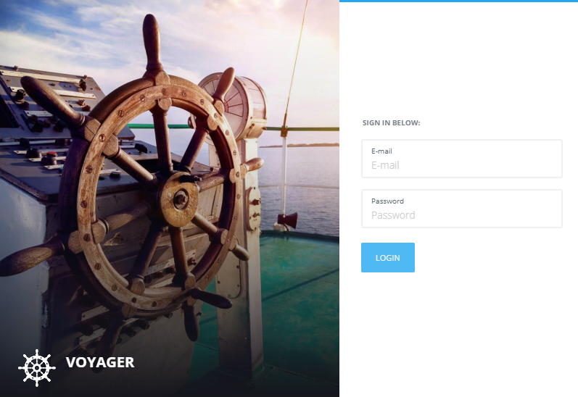
Functional Prototype: Owner Dashboard
The first step in creating the functioning app was a making a back-end that the app communicates with to get data. Such handles some of the following tasks:
Storing user/session information
Trip information
Location data for users/tour guides
Photos & Media
We call the dashboard “Voyager” - an homage to the great possibilities this system will allow our client to unlock.
Notes:
Brendan -
Intro: With the app, we required a backend for communication to consist between users, and to store data. The dashboard works with the iOS/Android apps at the same time.
Outro: Through this dashboard, our client and his employees can access and modify information displayed on the app, and information about registered users/tour guests.

Slide 14
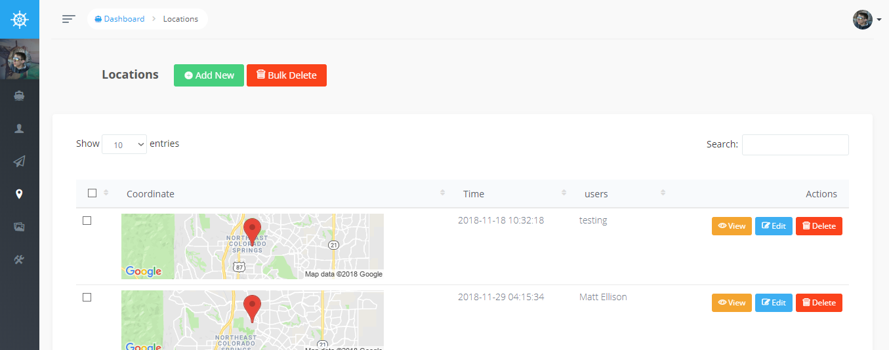
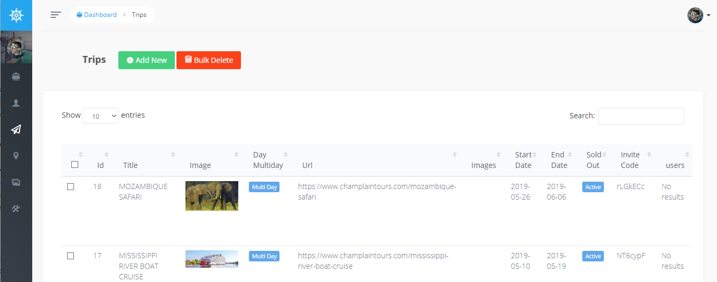
Functional Prototype: Dashboard Example Pages
Notes:
Brendan
Intro: Each screen of the dashboard is similar, displaying a different data point.
Middle: (Talk about various data points, API)
Outro: All of this setup was necessary to drive the app so that it could access data from the cloud across devices; and so the app could easily be managed from a web interface much like a website builder, except its for the app.

Slide 15
Functional App:
Demo & Walkthrough
Notes:
Justin

