Slide 1
Longevity Wellness App
Developed by:
William Kronfeld, Seamus Downey, Mauricio Aquino, AJ Tuttle,
Jesse Roberts, Grace Neumayer, and Johnny Seay
Designed by:
Cheyenne McCoy

Slide 2
Overall App Design and Functionality Walkthrough
Designed using Adobe XD creative software
Walkthrough describes use case and functionality of each screen, including screens still in development
✓ = Included in app demo
* = Not included in app demo

Slide 3
Account Setup Screen✓
Users are directed to account setup upon first login
Users upload their GI, NutrEval, and SpectraCell test files upon account creation*
Users can search for and chose all food related allergens and dietary preferences to refine recommendations
Users enter their general health information and have the ability to setup a smart device for live monitoring

Slide 4
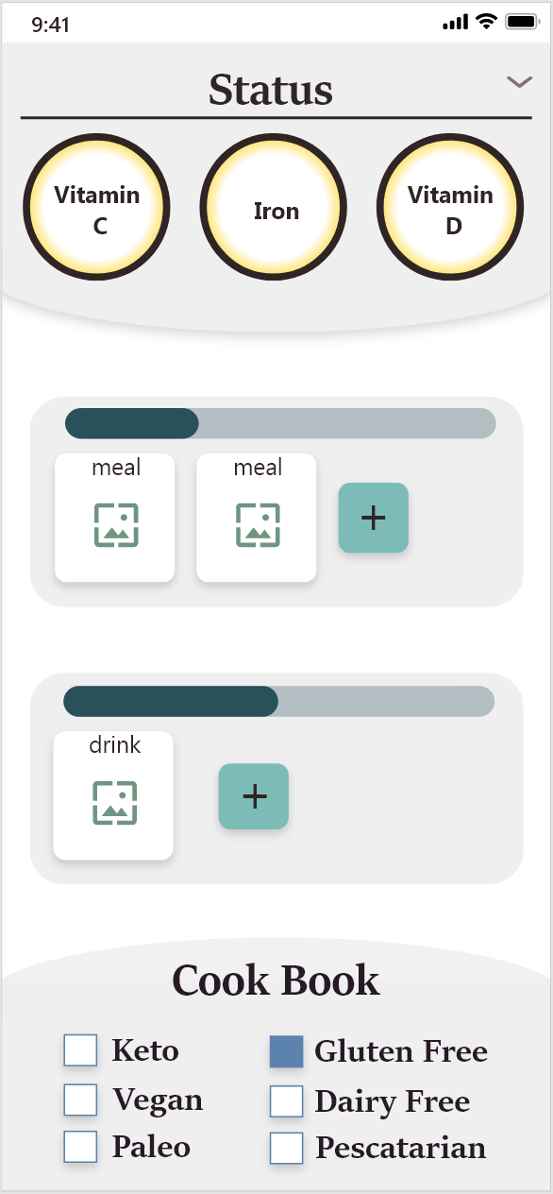
Home Screen✓
Home Screen acts as central hub for many other screens
Bottom of the nutrition screen is visible from the home screen to display key nutrition tracking information
Users can include their daily meal and drink intake to easily track their nutritional goals
Top of the cook book screen is visible from the home screen to display all dietary preferences being taken into account

Slide 5
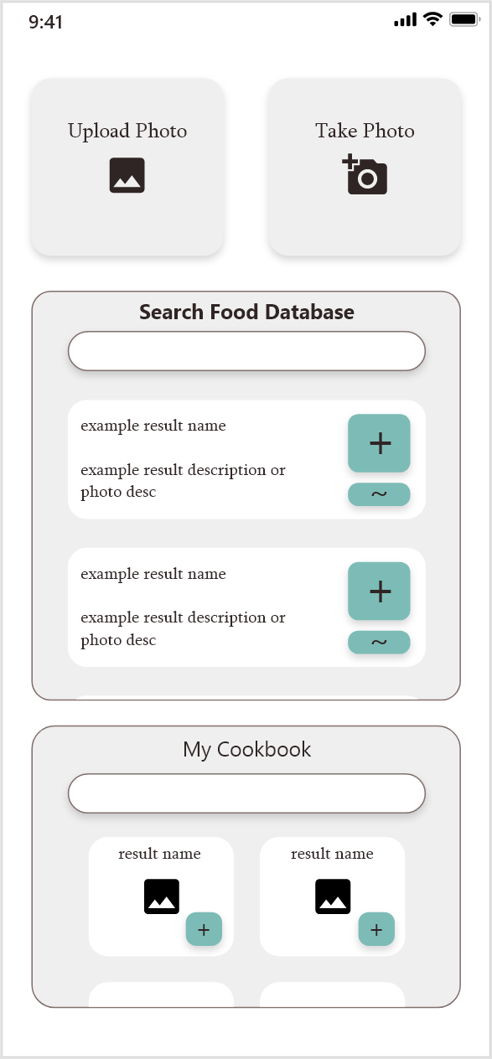
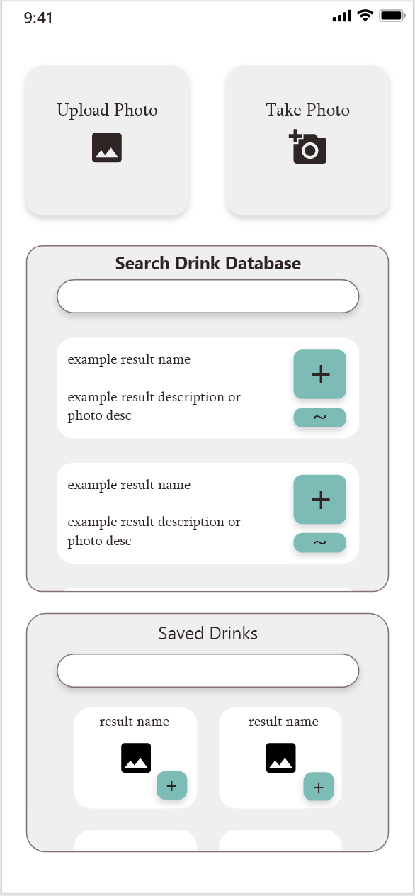
Meal✓ and Drink* Tracking Screens
Users can upload or take a photo of a food or drink for it to be automatically tracked within the app
Alternatively, users can easily search the USDA food/drink database to find the appropriate item to track
Favorited foods and drinks will be displayed so that users can easily reference them in the future

Slide 6
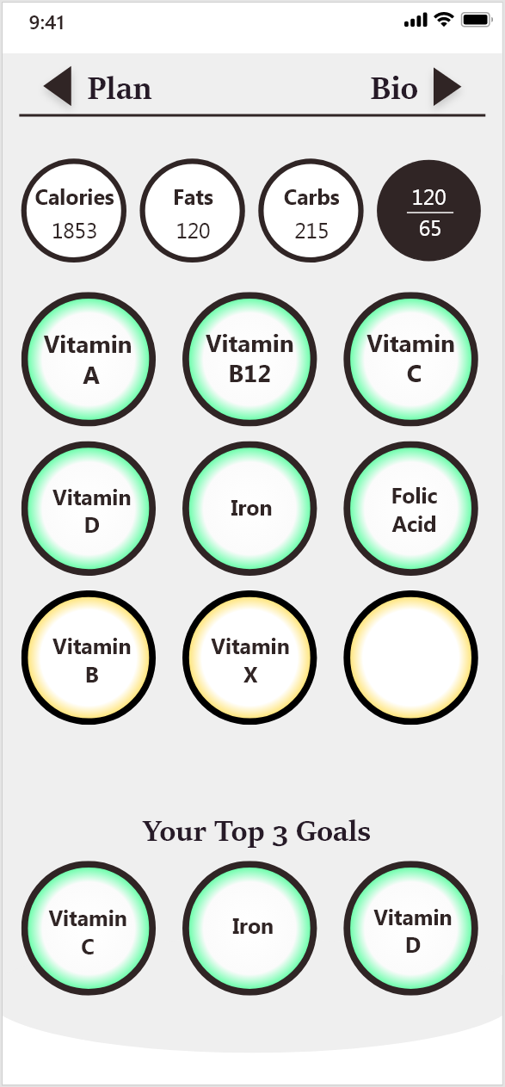
Nutrition Screen✓
Responsible for all nutrition deficiency, goal, and intake tracking
Macronutrient tracking keeps count of total daily calorie, fat, protein, and carbohydrate intake
Micronutrient tracking keeps count of daily intake of assorted micronutrients
Border color shifts from red to green as users come closer to hitting their daily intake goals
User can move any micronutrients into their “Top 3” goals section to always be visible from the home screen

Slide 7
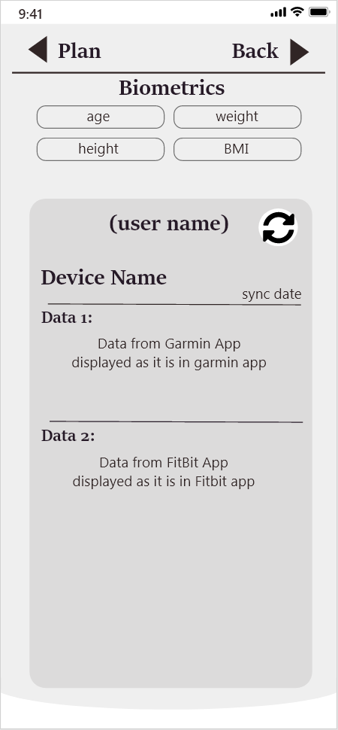
Bio Screen*
Bio screen is responsible for the tracking of all user biometric information
Users can view and edit their basic health information that was set at account creation
Users can view their real time health data collected from their synced smart devices and associated apps

Slide 8
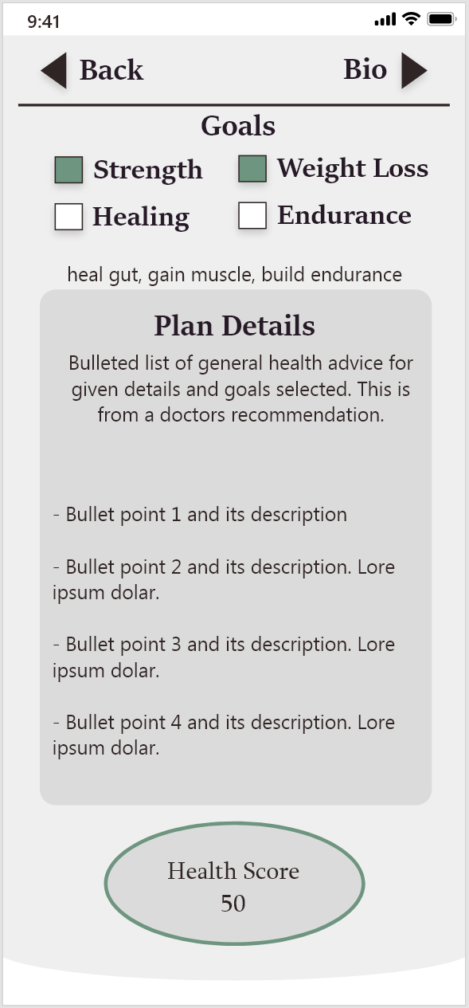
Plan Screen*
Plan screen is responsible for setting health goals and receiving recommendations from user’s assigned practitioner
Users select general health goals they wish to achieve
The user’s assigned practitioner has the ability to directly add recommendations into the user’s account to help guide them based on selected goals
Users will be provided with a “health score” that indicates how well they have adhered to their goals over the previous 7 days

Slide 9
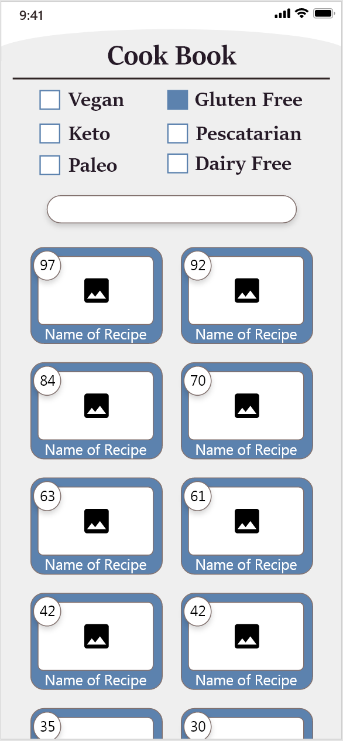
Cook Book Screen*
Cook Book screen houses Longevity Wellness’ preapproved, health focused recipe list
User’s dietary restrictions are set upon account setup and can be changed at any time
User can narrow the cook book’s returned recipes by searching for keywords
List view of all Longevity Wellness preapproved recipes that promote a healthy diet
Upon selecting a preapproved recipe, the respective recipe screen will be presented for users to follow

Slide 10
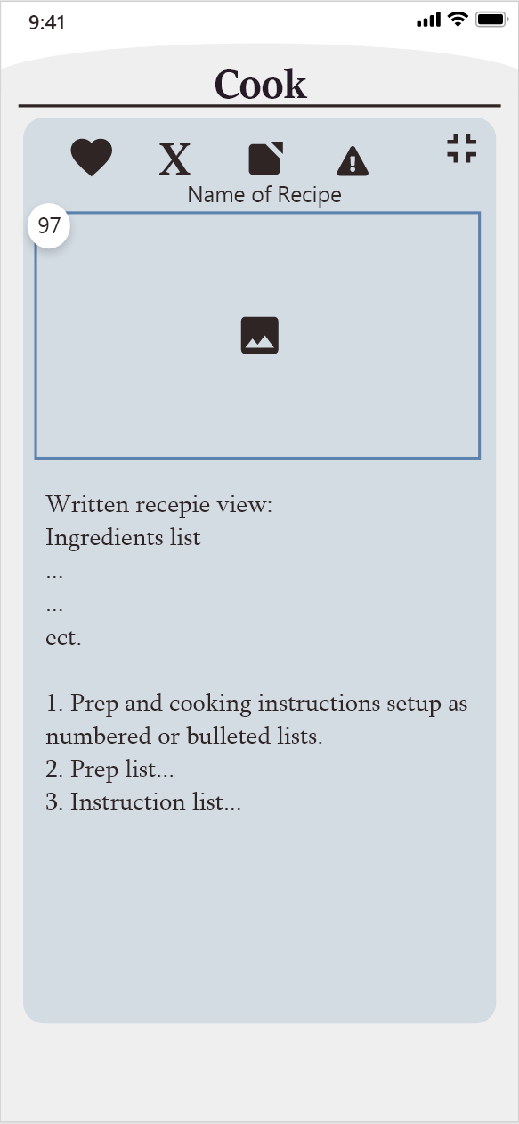
Recipe Screen✓
Recipe view allows users to view ingredient/nutrient breakdowns as well as recreate meals
Users have the option to favorite, remove, copy, or report a recipe
Image of food will appear hear if identified via file upload or photo
Entire ingredients list and nutritional breakdown of the food is displayed to the user
Prep and cooking instructions for the selected recipe is displayed for users to follow along*

Slide 11
Prototype App Development Progress Demo
Development timeframe: Sept 2020 – Dec 2020
Demo conducted through GIF images for record keeping purposes and ease showcase via virtual meeting

Slide 12
User Registration and Login
Straight forward account registration process
Unique accounts tied to user’s email and username
Enforced password length and complexity for security

Slide 13
Initial Account Setup
Account setup required at first login
Allergen list used to refine recipe recommendations to user
Dietary preference list used to further refine recipe recommendations
General biometrics used to track user’s starting point and progress over time

Slide 14
Tracking a User’s Meals
Meals can be added to the meal tracker via image recognition or manual search
Image recognition is currently limited to small subset of foods
Manual search can identify any food registered with the USDA
Meals added to the meal tracker are immediately calculated into user’s daily intake
“My Cookbook” stores any meal/recipe saved by the user for easy future access

Slide 15
Viewing a Specific Meal’s Details
Details of individual meals can be accessed from the home screen or “My Cookbook” section
Users can favorite, remove, copy, or report meals/recipes
Includes a detailed list of all ingredients and full nutritional breakdown
recipes added from Longevity Wellness’ preapproved recipe list would include follow along cooking instructions

Slide 16
Tracking a User’s Daily Intake
Nutrition screen is dragged down from the top of the home screen
Keeps track of user’s daily caloric, macronutrient, and micronutrient intake
Each micronutrient has a progress indicator to show progress towards reaching the user’s recommended daily intake
Progress indicators shift from red to green as users come closer to reaching their recommended intake
Progress indicators shift back towards red as users begin to exceed their recommended intake

Slide 17
Questions & Feedback

